Slide 1
Comparison of Music Lyric Generation Methods: Markov Chains and LSTM RNN
Kerem Enhoş
Muralikrishna Shanmugasundaram
William Varner
Yunus Cem Yılmaz

Slide 2
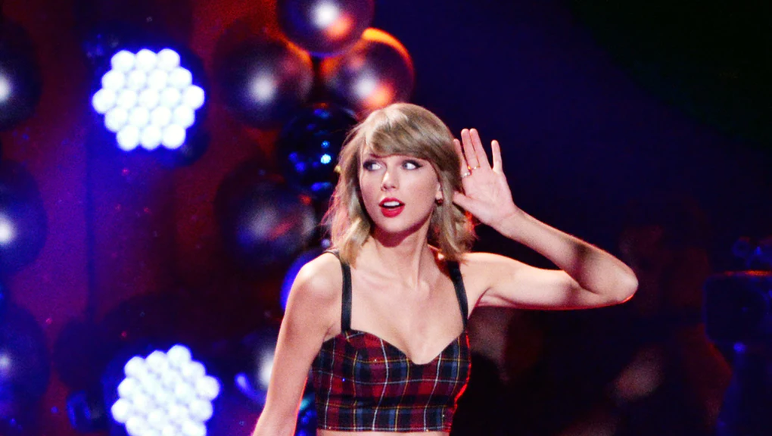
Overview
Introduction:
“Pop” is a wide, popular genre of music
Machines can create lyrics
Use famous songs to create a new “hit”
Project:
Sample Genius’s Top 100 Pop Songs
Generate structure with k-means
Generate language with Markov Chain and LSTM RNN

Slide 3
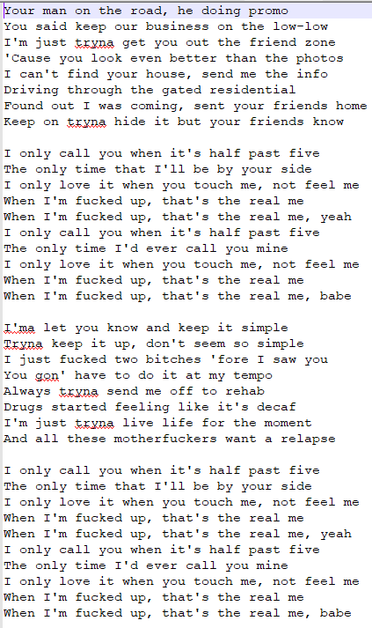
Song Modeling
6D data vector
# of sections
Average # of lines/section
Std. dev of lines/section
Average # of words/line
Std. dev of words/line
Repetition score
GOAL: identify popular song formulas

Slide 4
Clustering Algorithm
We employ the “Silhouette Method”, a visualization method that helps to determine the optimal number of clusters.
The silhouette of a data instance is a measure of how closely it is matched to data within its cluster and how loosely it is matched to data of the neighboring cluster.
The range of the Silhouette value is between +1 and -1.
A high value is desirable and indicates that the point is placed in the correct cluster. If many points have a negative Silhouette value, it may indicate that we have created too many or too few clusters.

Slide 5
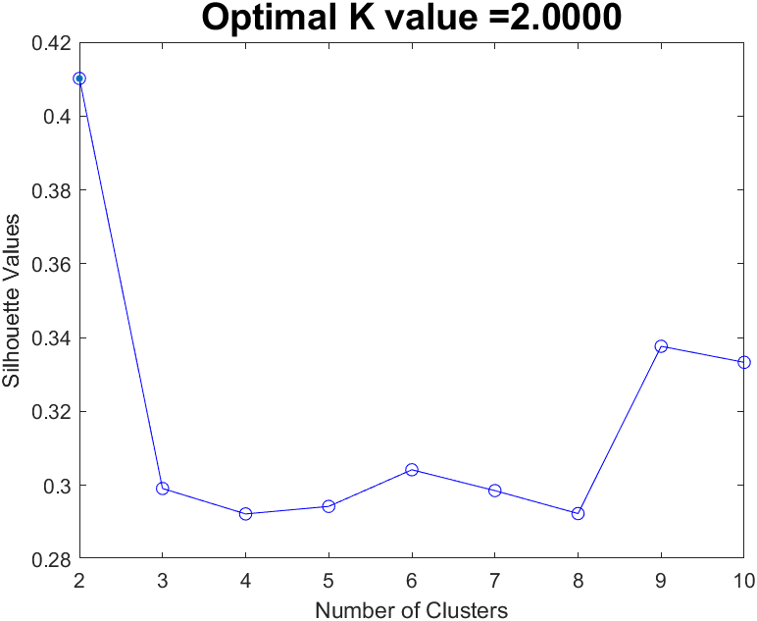
The Silhouette Values is calculated in MATLAB using evalclusters() function.
Now using the appropriate k value, k-means clustering is performed with the songs dataset using kmeans() , which returns the cluster indices and cluster means of each data points.

Slide 6
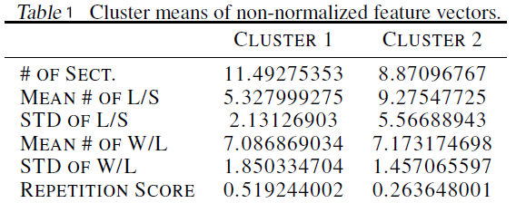
The cluster results will be used to decide on the lyric structure (different lyrics for each cluster will be generated).
When standard deviations are provided will be used and the variable means to draw from a normal distribution and choose the thresholds for the no. of words in a line and no. of lines in a section accordingly.
For the repetition of sections, one of the first two lines will be selected as the chorus and repeat it according to the following rule: it will be drawn from a uniform distribution between 0 and 1 for every section. Then it will be compared to the drawn values with the repetition score and if the repetition score is larger, this section will be chosen as the chorus instead of an original line.

Slide 7
Phonetic Alphabet Converter
Translate Dataset to IPA
Generate Lyrics with Markov Chain
Translate Generated Lyrics to English
Homophone words can be paired more easily when the similarity between words is assessed in International Phonetic Alphabet (IPA).
Mechanical rhyming with greater precision is obtained with using Levenshtein distance.
A dictionary with the words that are uniquely used in the dataset is constructed, and the IPA equivalent of these words are stored in a Python dictionary.
hi sɛd ðə we maɪ blu aɪz ʃaɪnd
pʊt ðoʊz ˈʤɔrʤə stɑrz tɪ ʃem ðət naɪt
aɪ sɛd, "ðæts ə laɪ"
ʤɪst ə bɔɪ ɪn ə ˈʧɛˌvi trək
ðət hæd ə ˈtɛndənsi əv gettin*' stək
He said the way my blue eyes shined
Put those Georgia stars to shame that night
I said: "That's a lie."
Just a boy in a Chevy truck
That had a tendency of gettin' stuck

Slide 8
Markov Chain Model
Rhyming forces us to go backwards while building our models
Markov model with a single word:
Your love [was] handmade for somebody like me
I’m in love [with] the shape of you
Markov model with two words:
Your love [was handmade] for somebody like me
I’m in love [with the] shape of you

Slide 9
Markov Chain without IPA Sample Section
Begins we watched the ritual
They test me my love the real
Cities and I will never go tell
Seat of style is you seen a small
Looks like tomorrow when family's all
To his gift keeps on them ill

Slide 10
Markov Chain with IPA Sample Section
Of we are well I seem a bottle
You my body rock is it up double
And I know that clap clap clap along
Almost a few things that thong
A nation pretty but I’m in line do what
In the other like happiness I do what
I always in love me up all

Slide 11


Long Short-Term Memory Recurrent NN Model
We will be using a bidirectional LSTM RNN
Previous and next 10 words are used to predict the word
Categorical cross-entropy minimization with root mean square propagation algorithm
5 layer, 250 perceptron, 20 epoch, 0.2 validation set model
Sigmoid transfer functions in hidden layers, softmax in output layer

Slide 12
LSTM RNN Sample Section
That’s why look in the known and when
We go crashing down we
Come back every time just cause everybody is your mind
But I love it to marriage
But I’ll only stay with you one more

Slide 13
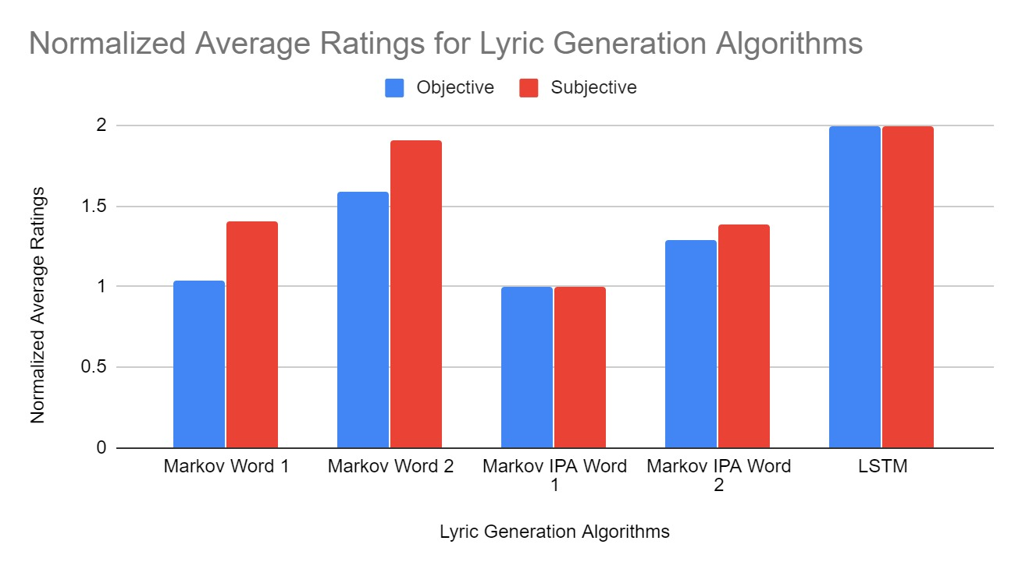
Results
We have taken 10 samples out of every model and song combination and scored them
Ratings are based on personal preferences (subjective) and grammatical correctness (objective)

